Slide 1

Legal Domain Classification
Team_No:19
Sr.No | Reg.no | Name of the Student
1. | BL.EN.U4AIE23018 | M . Manish Kumar Reddy
2. | BL.EN.U4AIE23045 | G . Jayanth
3. | BL.EN.U4AIE23054 | D . Naga Gowtham Raj
Project Advisor:

Slide 2
Agenda
Introduction
Problem Statement
Data Description
Technical Description
Implementation
Conclusion
Notes:
Leekhith

Slide 3
Introduction
Legal documents are increasing rapidly, requiring automated classification.
Legal text classification aids in retrieval, prediction, and analysis.
Challenges include complex language, class imbalance, and high dimensionality.
LegalBERT provides legal-domain-specific text embeddings.
LegalBERT embeddings are used as input features for ML models.
SMOTE is applied to balance the dataset by oversampling minority classes.
PCA and SelectKBest reduce dimensionality and improve efficiency.
Models used: Logistic Regression, Random Forest, SVM, XGBoost, CatBoost, Decision Tree, AdaBoost, Naïve Bayes, KNN, MLP.
Hyperparameter tuning is done using GridSearchCV.
Study validates LegalBERT, improves accuracy with SMOTE, and compares ML models.
Notes:
Leekhith

Slide 4
Problem Statement
The exponential growth of unstructured legal documents has made manual classification inefficient and unsustainable. Traditional text classification models often fail to capture the complex and domain-specific language used in legal texts. Additionally, legal datasets typically suffer from significant class imbalance, which leads to biased model performance favoring majority classes. The high dimensionality of text features further complicates model training and reduces computational efficiency. Therefore, there is a pressing need for an automated, scalable, and accurate legal domain classification system that can effectively address class imbalance and feature space complexity.
Notes:
Leekhith

Slide 5
Data Description
Class Distributions
The dataset consists of 3,229 legal judgments, each represented by a 768-dimensional LegalBERT embedding vector.
There are 14 distinct classes in the target label (Label), representing different types or outcomes of judgments.
Preprocessing
Input Features: Each legal document is represented using 768-dimensional embeddings generated by LegalBERT.
Data Cleaning: Not applicable since inputs are already vectorized embeddings.
Standardization:
Performed using StandardScaler (from sklearn.preprocessing).
Applied to scale embedding features before training the models.
Ensures models like SVM, Logistic Regression, and KNN perform optimally by centering and scaling the features.
Train-Test Split:
Typically done using an 80-20 ratio, stratified by class to preserve distribution.
Notes:
Leekhith

Slide 6
Data Description
Implemented Classifier:
1. A total of 10 machine learning models were trained and evaluated under two setups:
Without SMOTE: Using the original imbalanced dataset.
With SMOTE: Applied to handle class imbalance by synthetically oversampling minority classes.
Models Used:
Logistic Regression
Random Forest Classifier
XGBoost Classifier
Support Vector Machine (SVM)
K-Nearest Neighbors (KNN)
Decision Tree Classifier
Gaussian Naive Bayes
AdaBoost Classifier
Multi-Layer Perceptron (MLP Classifier)
Naive Bayes
Notes:
Leekhith

Slide 7
Data Description
Hyperparameter Tuning:
1. Applied Grid Search with Cross-Validation.
2. This tuning process helped optimize model parameters such as:
3. Number of trees, depth, regularization, learning rate, and kernel type.
Class Imbalance Handling
Without SMOTE:
Baseline classification using imbalanced data.
Performance metrics show bias toward majority classes (especially class 0).
With SMOTE (Synthetic Minority Over-sampling Technique):
Balanced the dataset by synthetically oversampling minority classes.
Improved recall and F1 scores for minority classes.
Dimensionality Reduction
1. Principal Component Analysis (PCA): Applied to embedding vectors, preserving 95% variance.
2. Reduces dimensionality, mitigates curse of dimensionality, and enhances computational efficiency.
Notes:
Leekhith

Slide 8
Technical Description
Algorithms:
Input:
Raw legal case judgment texts.
Each record represents a court decision or case summary.
Embedding Extraction:
Used LegalBERT to generate dense vector embeddings.
[CLS] token or pooled layer used to represent each case document numerically.
Class Balancing:
Applied SMOTE to oversample the minority class.
Balances training data and improves classification fairness.
Notes:
Rakesh

Slide 9
Technical Description
Algorithms:
Dimensionality Reduction:
Used PCA to reduce embedding size.
Enhances efficiency and reduces overfitting.
Model Training: Train classifiers (KNN, XGBoost, Random Forest, Naive Bayes, MLP, SVM, Decision Trees, AdaBoost, Logistic Regression, Naïve bayes) with grid search for hyperparameter tuning to optimize performance.
Evaluation and Interpretation: Compute training/testing accuracies, analyze the impact of PCA and hyperparameter tuning, and compare model.
Notes:
Rakesh

Slide 10
Implementation Details
Embedding Extraction:
Used LegalBERT, a transformer model pretrained on legal corpora, to process judgment texts.
Extracted [CLS] token embeddings for each document, producing dense vector representations suitable for classification.
Dimensionality Reduction:
Applied Principal Component Analysis (PCA) to reduce high-dimensional LegalBERT embeddings.
Retained top components explaining most variance, improving training efficiency and reducing overfitting.
Notes:
Vignesh

Slide 11
Implementation Details
Dataset Balancing:
Applied SMOTE to handle class imbalance by generating synthetic minority class samples.
Improved model performance, especially recall and F1-score for underrepresented classes.
Machine Learning Models Used:
Logistic Regression
Random Forest Classifier
XGBoost Classifier
Support Vector Machine (SVM)
K-Nearest Neighbors (KNN)
Decision Tree Classifier
Gaussian Naive Bayes
AdaBoost Classifier
Multi-Layer Perceptron (MLP Classifier)
Naive Bayes
Notes:
Vignesh

Slide 12
Implementation Details
Libraries Used:
Scikit-learn for:
Machine learning classifiers (SVM, RF, KNN etc.)
PCA for dimensionality reduction
pandas, NumPy for data processing
matplotlib, seaborn for visualizing results
Notes:
Vignesh

Slide 13
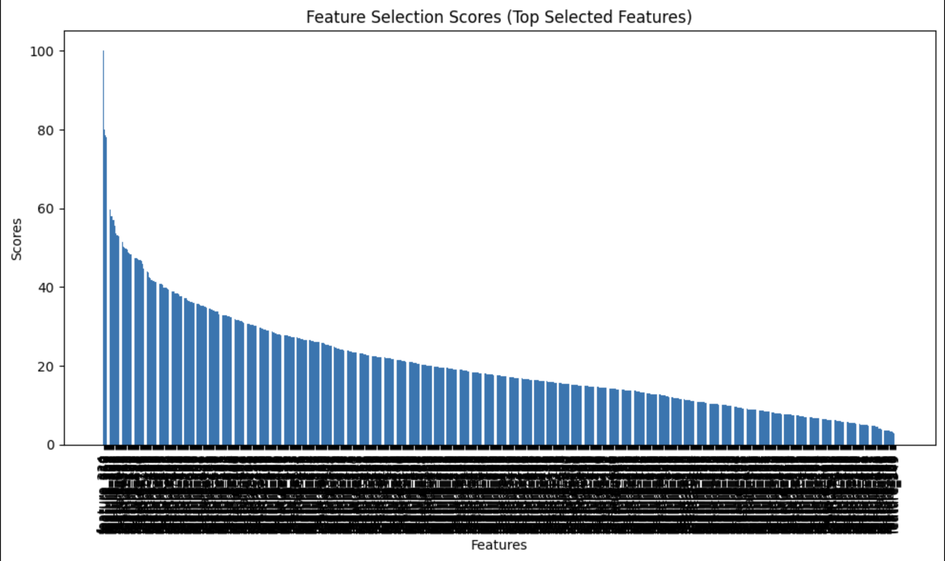
Results & Analysis
Without SMOTE
Notes:
Vignesh

Slide 14
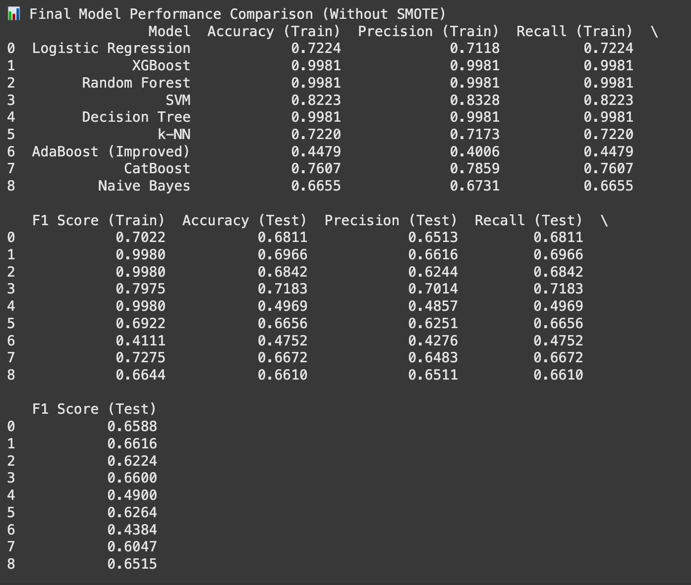
Results & Analysis
Without SMOTE
Notes:
Vignesh

Slide 15
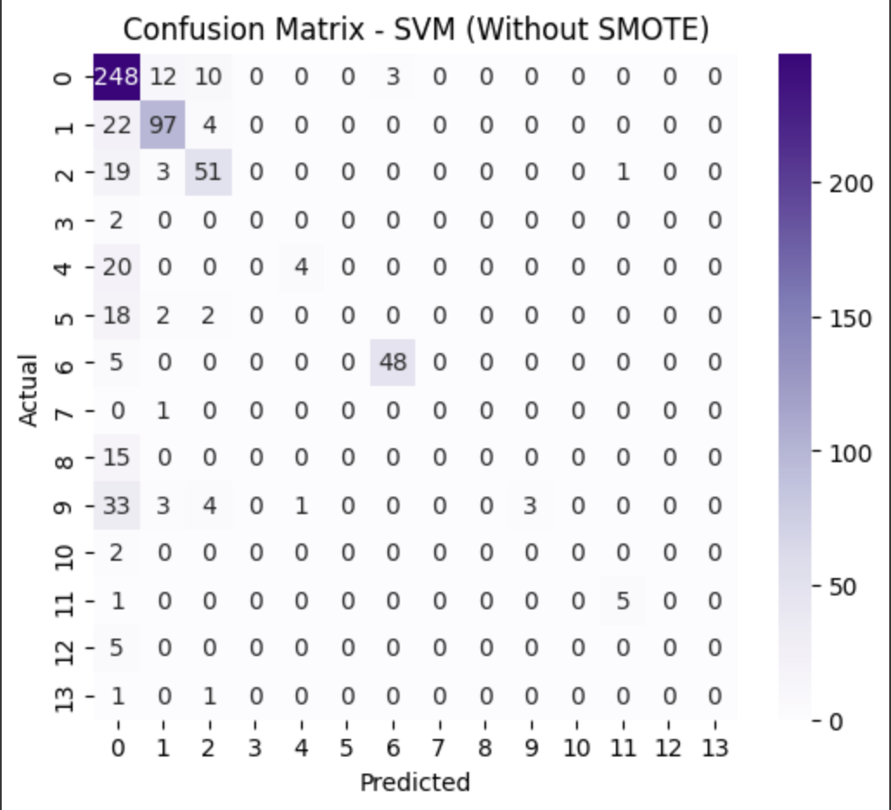
Results & Analysis
Without SMOTE
Strong performance for class 0 (248 correct predictions)
Moderate performance for classes 1 (97 correct), 2 (51 correct), and 6 (48 correct)
Poor or zero recognition for classes 3, 7, 8, 10, 12, and 13
Significant class imbalance evident in the matrix
Misclassification pattern: Many instances from minority classes predicted as class 0
Overall accuracy: Inflated due to good performance on majority classes
Class confusion: Notable between classes 0, 1, and 2
Model bias: Heavily favors majority classes in predictions
Notes:
Vignesh

Slide 16
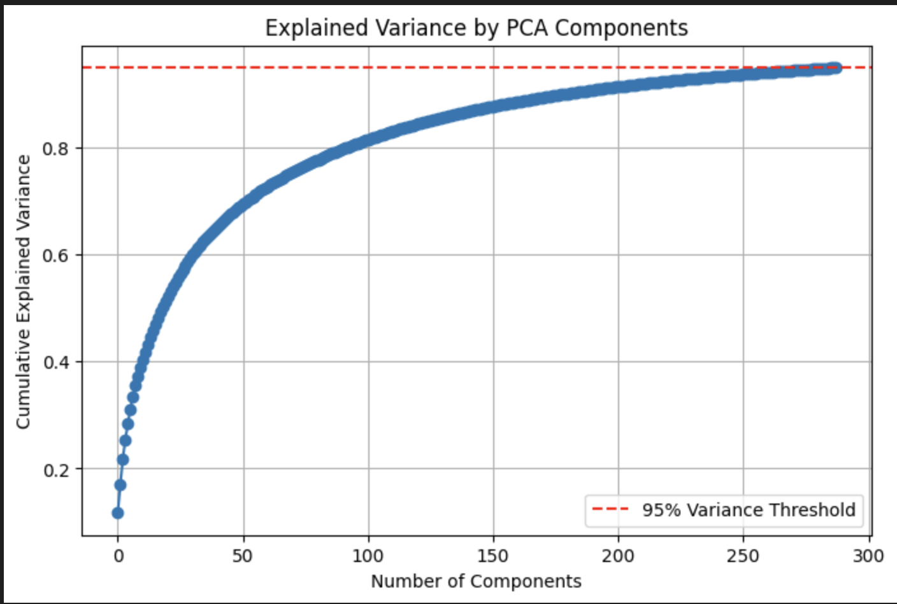
Results & Analysis
With SMOTE
Notes:
Vignesh

Slide 17
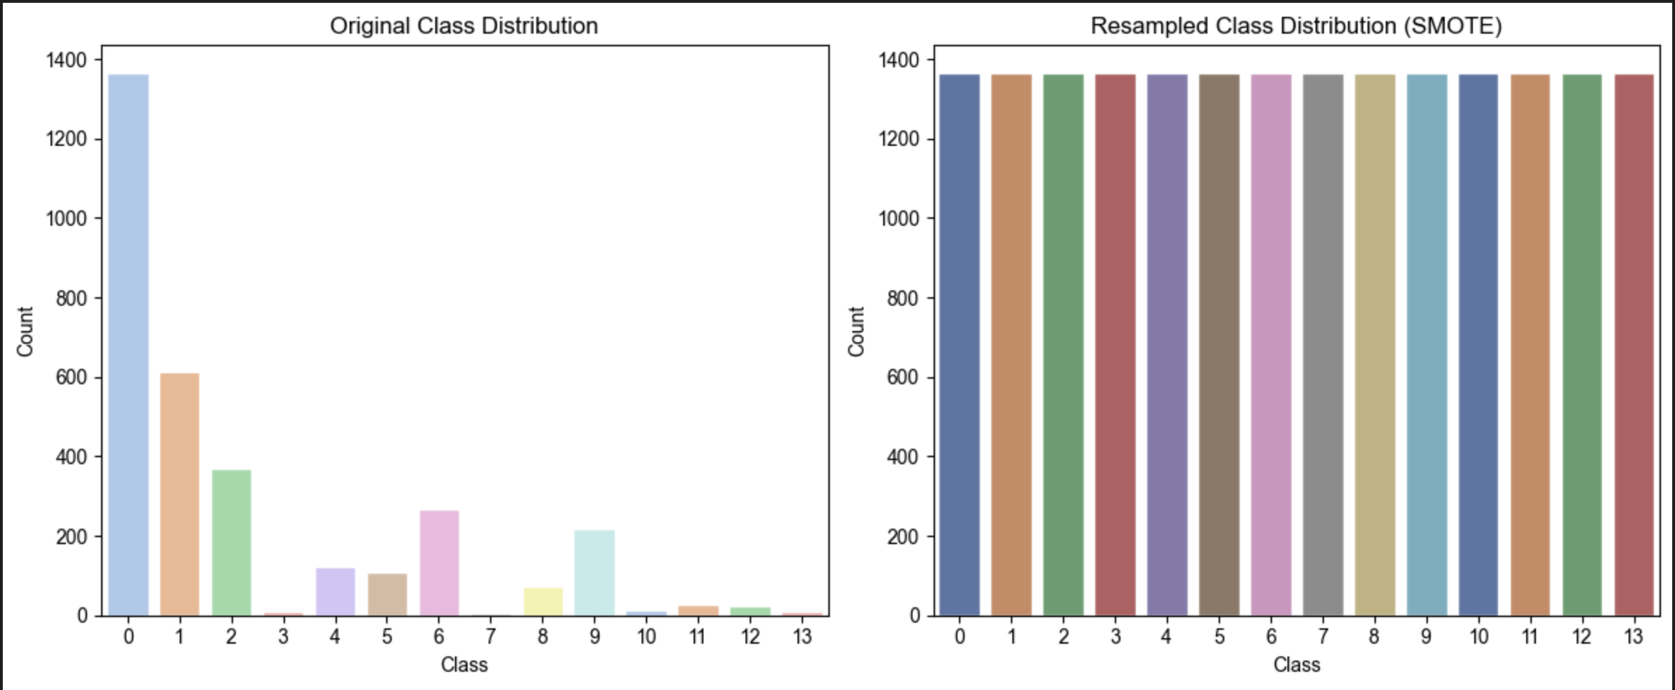
Results & Analysis
With SMOTE
Notes:
Vignesh

Slide 18
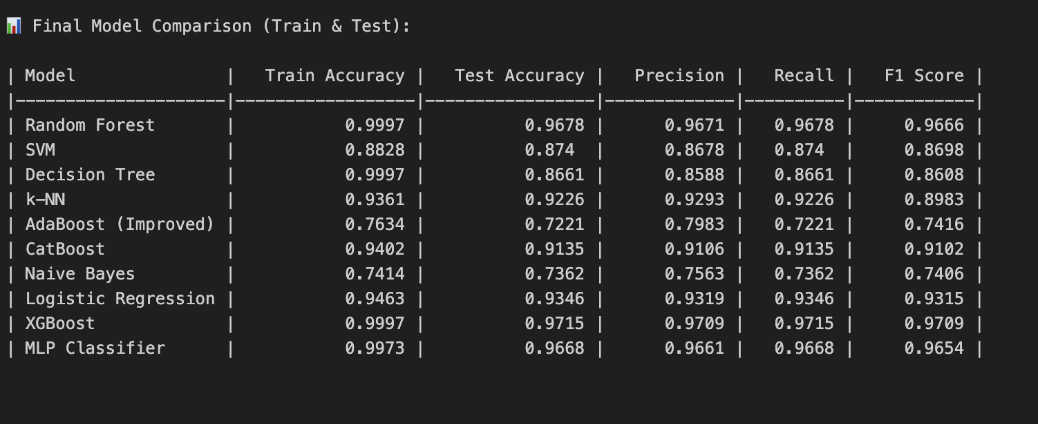
Results & Analysis
With SMOTE
Notes:
Vignesh

Slide 19
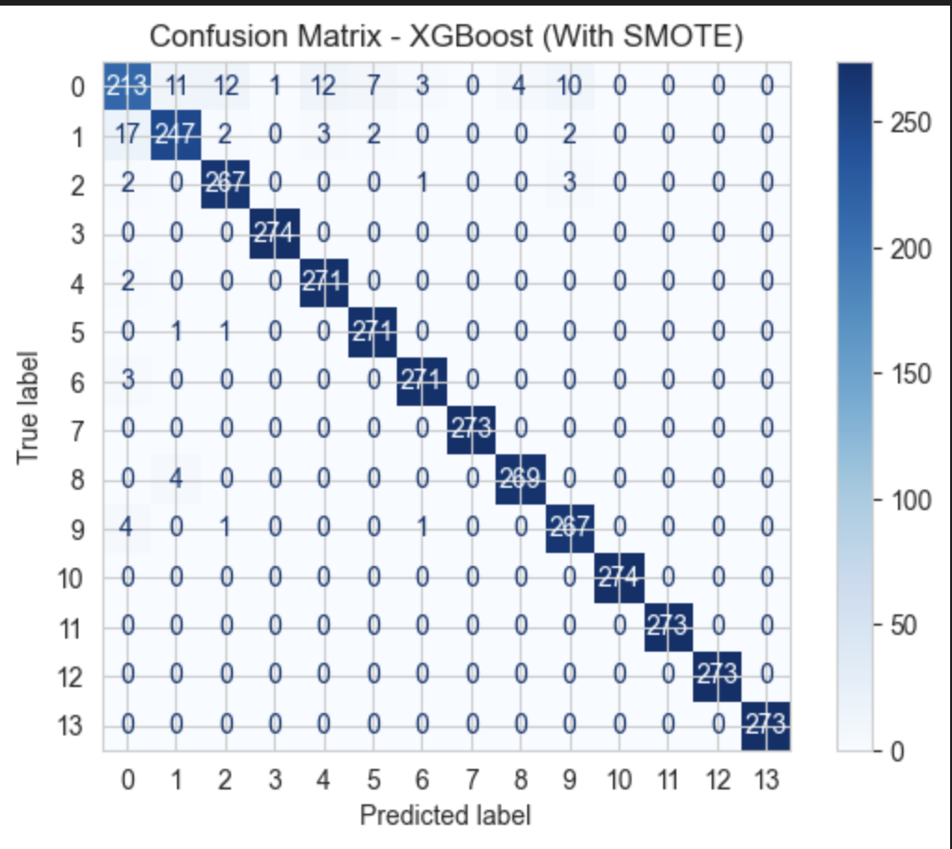
Results & Analysis
With SMOTE
Excellent overall performance across all 14 classes (0-13)
High prediction accuracy with strong diagonal values (~270+ correct predictions per class)
Balanced class representation achieved through SMOTE implementation
Minimal misclassification between different classes
Class 0 confusion: Some misclassification with classes 1, 2, 4, and 9
Class 1 performance: Strong with 247 correct predictions, minor confusion with class 0
Class equality: Nearly identical performance across all classes
SMOTE effectiveness: Dramatically improved minority class recognition
Model robustness: Consistent performance regardless of original class distribution
Significant improvement: Complete elimination of zero-recognition classes seen in SVM model
Notes:
Vignesh

Slide 20
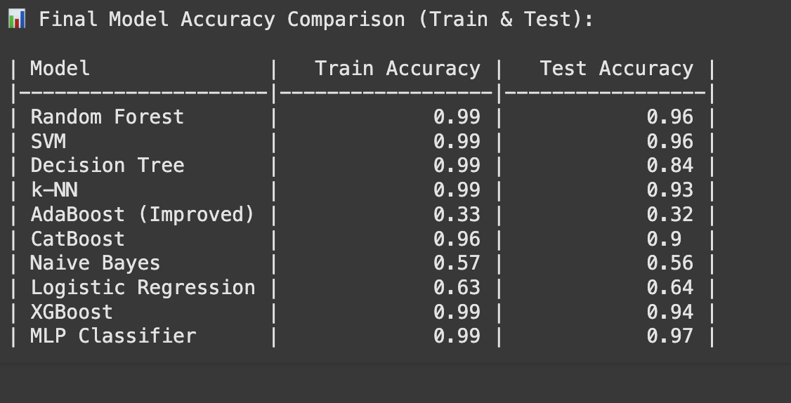
Results & Analysis
Hyperparameter Tuning
Notes:
Vignesh

Slide 21
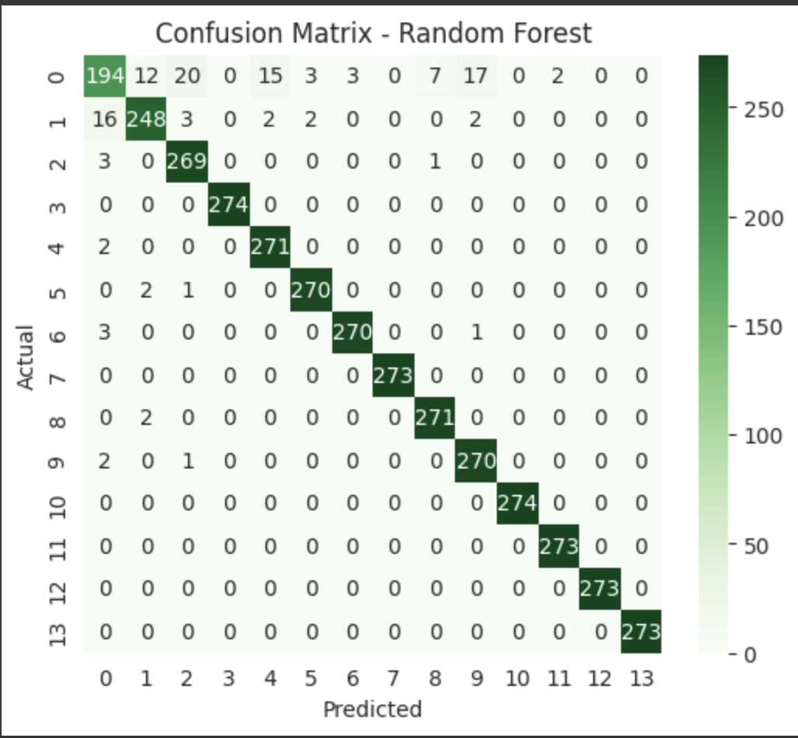
Results & Analysis
Hyperparameter Tuning
Strong overall performance with high correct predictions across all classes
Class 0 challenges: Notable confusion with classes 2, 4, 8, and 9
Class 1 excellence: Highest accuracy (248 correct) with minimal misclassification
Perfect prediction for classes 3, 10, 11, 12, and 13 (zero misclassifications)
Balanced class performance: Consistently high diagonal values (~270+ per class)
Class 0-1 interaction: Bidirectional confusion between these classes
Minority class recognition: Excellent performance across all classes
Model robustness: Consistent accuracy regardless of class distribution
Limited confusion patterns: Most misclassifications involve class 0 or 1
Notes:
Vignesh

Slide 22
Conclusion:
This study bridges the gap between high-dimensional legal texts and smart automation using LegalBERT embeddings and robust machine learning pipelines. By addressing the inherent issues of high-dimensional feature spaces and class imbalance, the project demonstrates how domain-specific embeddings with SMOTE and strict feature selection techniques can significantly enhance classification accuracy—especially for minority legal outcomes. With sustained experimentation with models such as SVM, Random Forest, and CatBoost, coupled with careful hyperparameter optimization, not only did we observe actual-performance improvements but also emphasized the value of balanced data and reduced features in legal AI systems. A feat over technicality, this work points to the revolutionizing power of AI in the legal sector: speeding up legal analysis, impartial judgment prediction, and paving the way for transparent legal technologies. Ultimately, this project is not so much about case-labeling—it's opening up justice at scale, one embedding at a time
Notes:
Rakesh

Slide 23

Thank you !!!!!
Notes:
All

